Slide 1
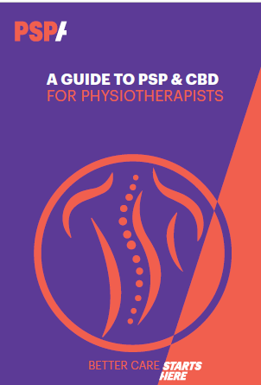
The development of the Physiotherapy Guidelines for PSP & CBD
October 21st 2022
Jade Donnelly, Ciara Baker, Rebecca Bray, Emma Secker, Louise McGregor
Notes:
Hi, my name is Jade Donnelly. I am the atypical parkinsonian syndromes coordinator and specialist physiotherapist. I work with 2 neurologist Dr Ghosh and Dr Massey and together we run the Wessex APS, a specialist clinic for those with PSP, CBS and MSA.
For the next session I am going to give you a brief back background to the guidelines and then there will chance to ask some questions.

Slide 2
Disclosures
Assessor for several commercial drug studies (UCB/Biogen/Novartis)

Slide 3
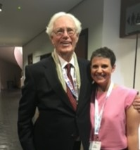
What was my motivation to write the guidelines?
Dr. Steele was one of the physicians at the University of Toronto who in 1963 and 1964 published the defining clinical and pathologic descriptions of PSP.
Notes:
John Steel first wrote about these conditions in 1963, I had the pleasure of meeting him in 2018, however knowledge about these conditions still remains poor in the fact that many therapists may never have heard of these conditions. This needs to change and the PSPA have been working hard on raising the awareness of these conditions. Everyone has heard of MND, we want everyone to know about CBS and PSP! Up until recently these conditions were not even coded.

Slide 4
Notes:
The red circles shows the QOL of the general population, of all ages using the EQ5D. This is relatively good.
To the right is good QOL
To the left is bad QOL.

Slide 5
Notes:
Compare that to those with Depression, it is roughly half of that of the general population, so worse.

Slide 6
Notes:
The QOL of life for those with MND is here, and is similar to those with Huntington's disease and ataxia’s

Slide 7
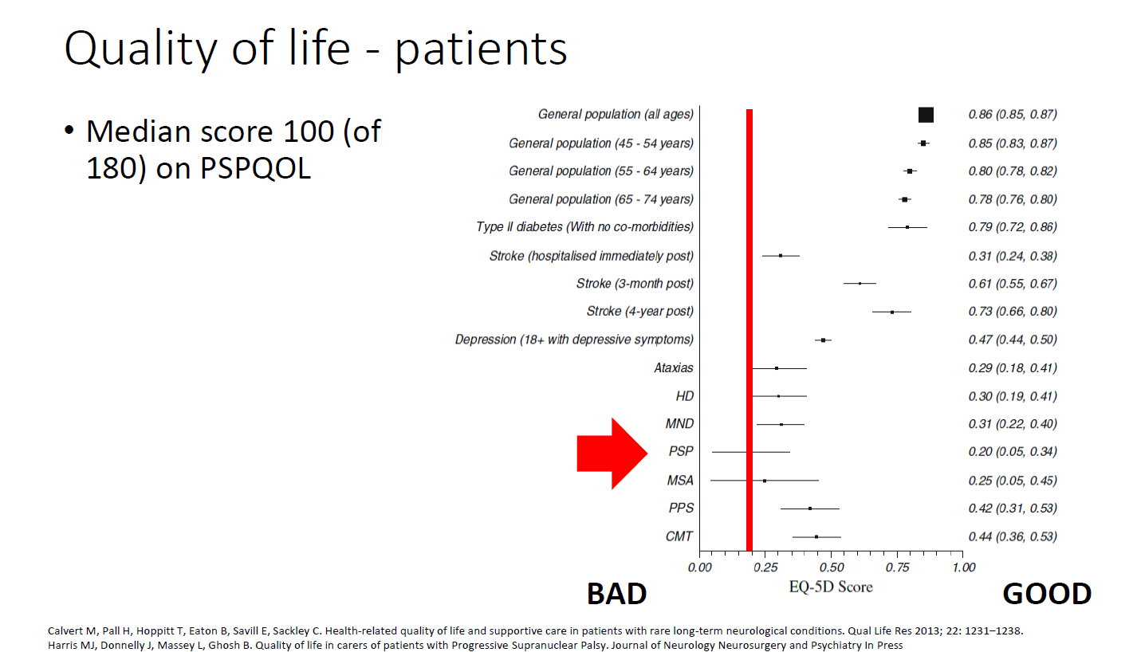
Notes:
The red line marks the QOL in PSP. It is the lowest of all these conditions and significantly lower than the general population, and lower than MND which like PSP and CBS is complex in its nature.

Slide 8
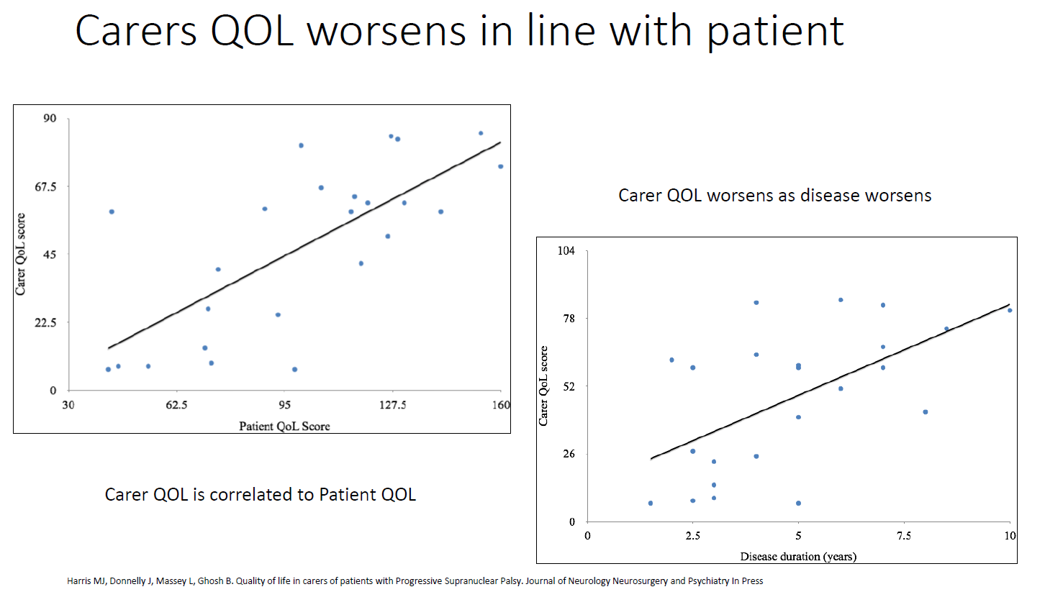
Notes:
We also know that carer QOL worsens in line with the patient with the condition.

Slide 9
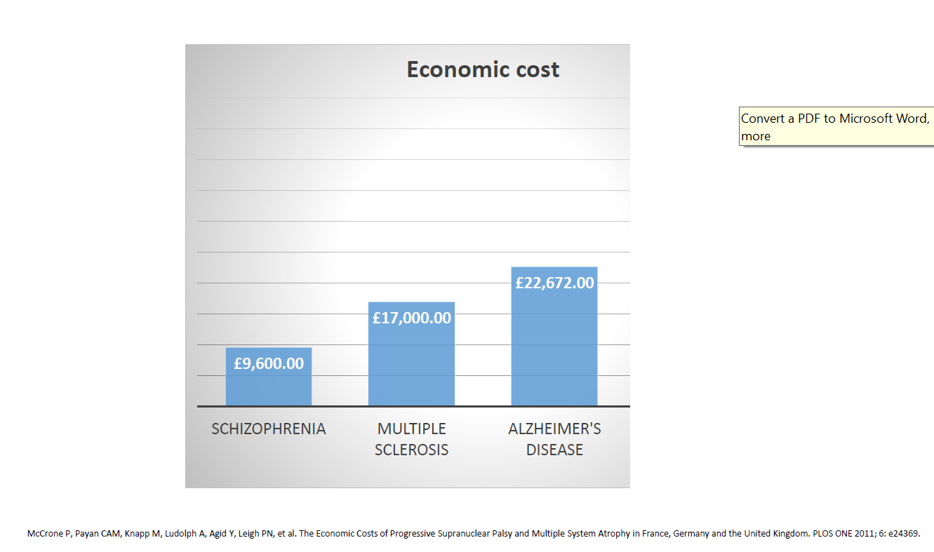
Notes:
We can see here the economic cost of various conditions.

Slide 10
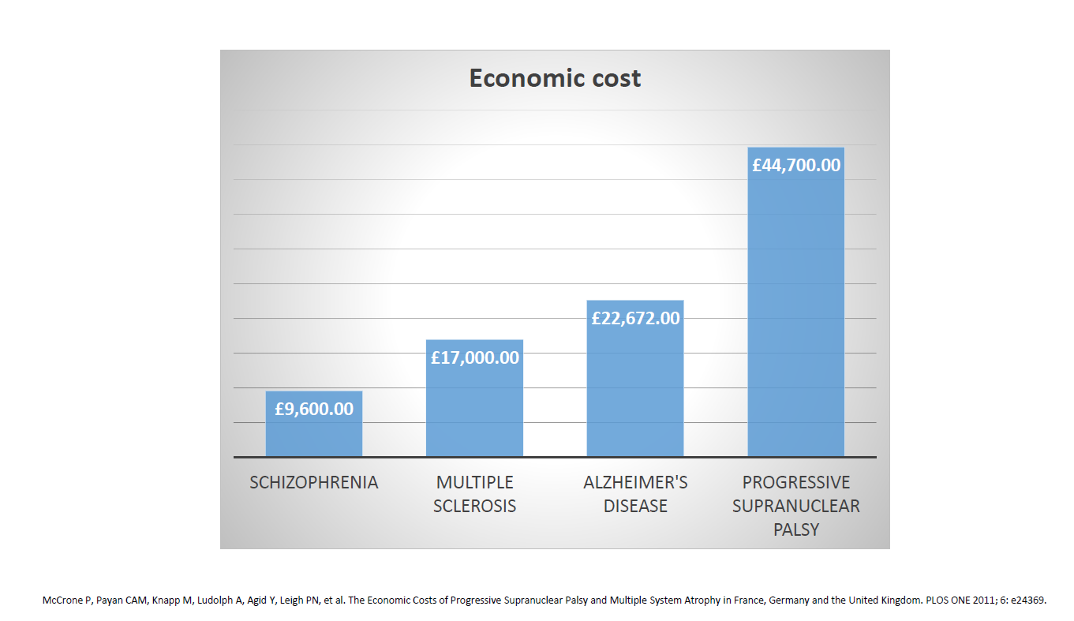
Notes:
Here PSP is double that of Alzheimer's.

Slide 11
Cost in England
Total cost to NHS annually for patients with PSP is £167 million
McCrone estimated 40% of costs were inpatient costs
PSP annual inpatient costs :
£66.8 million
Notes:
So, we should aim to avoid the need for hospitalisation!
Hopefully through better MDT management and awareness of these conditions we can help to reduce these costs.

Slide 12
Why?
Guide and inform our practice
Share knowledge
Share best practice
Share current evidence base
To enable us to build on these guidelines to create pathways and aspire to NICE guidelines.
Prior to these guidelines Physiotherapists could only refer to the OT or professionals guidelines.
Notes:
Pause….
But why have we done this
As a profession we near to …..

Slide 13
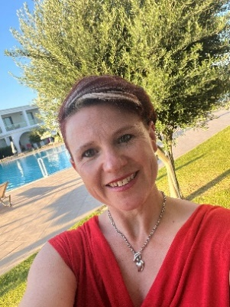
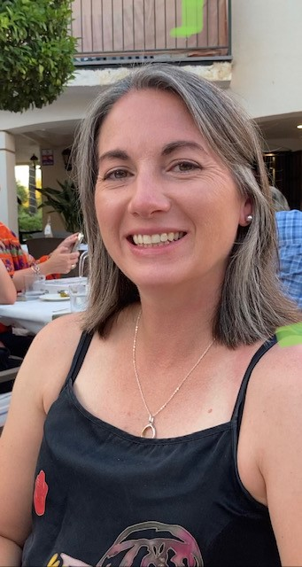
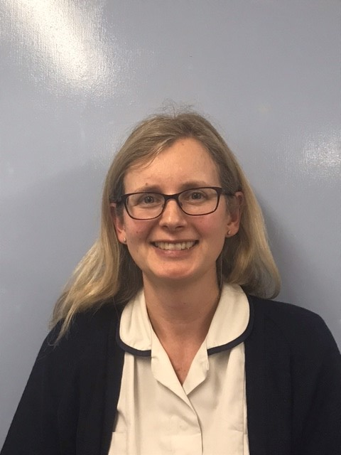
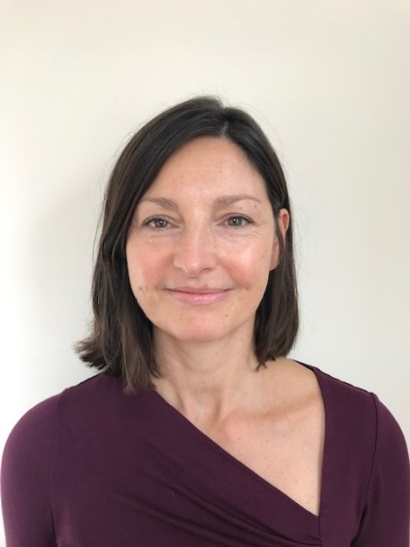
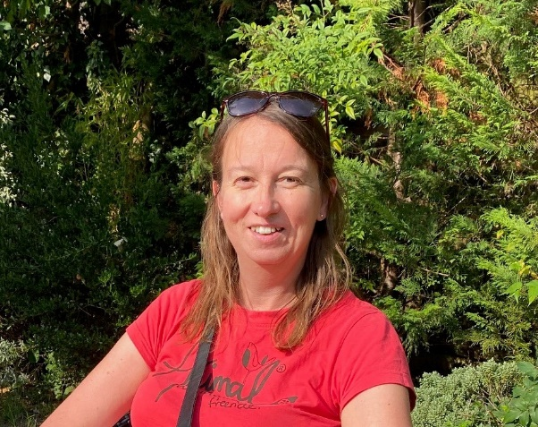
Jade Donnelly
Ciara Baker
Emma Secker
Rebecca Bray
Louise Mcgregor
Notes:
Who worked on the guidelines-
This is why we personally
For me, it’s a desire to make a difference and improve the patient experience. Weekly I speak to patients with PSP and CBS as well as their carers. I see first hand their challenges and frustrations. They value having someone who has heard of there condition and someone who has an insight into their problems. I remember advising a therapist in Birmingham who was seeking advice for a patient she was treating and she asked why is there no physio guide, I’ve read the OT guide and professional guide both were helpful but why no physio guide. So I was delighted when we were given the green light to go ahead with this project.
Ciara Baker – Clinical Specialist Neurological Practitioner, Community Neurology Service, Dorset has day to day hand on experience of these with these conditions in the community. Through her work she has seen how patients present differently and we need to adapt our approach accordingly and treat everyone as an individual.
Emma Secker – Specialist Palliative Care therapist in the community in Northumbria, she was keen to bring together her knowledge and experience of the condition from diagnosis to end of life care.
Louise Mcgregor- Therapy consultant at St Georges London was keen To increase knowledge on what best physiotherapy practice looks like throughout the course of the condition.
Rebecca Bray – Specialist neurological physiotherapist from Wiltshire was thrilled to be given the opportunity to improve experiences for individuals with progressive neurological disease and for more personal reasons. In 2015 her Dad was diagnosed with CBD/CBS. On attending his initial physiotherapy appointment he was advised that there was nothing that could be done to help him. She very much hopes that these guidelines will ensure than neither a physiotherapist or a person with PSP/CBD will have that same experience in the future.
Emma - I volunteered to contribute to the guidelines because I see PSP patients in my current role and was keen to further my knowledge about the condition. I felt it was a good opportunity to raise awareness of the condition and provide a resource for other physiotherapists, bringing together knowledge and experience of the condition from diagnosis to end of life care.
Louise- To have the opportunity to raise awareness of PSP for physiotherapists working with individuals and their carers.
To increase knowledge on what best physiotherapy practice looks like through the patient journey.
Ciara- : I was really very keen to be participating in developing these guidelines for Physiotherapists as I am working with clients to manage their conditions on a weekly basis. In order to offer to support our clients in the best possible way I felt it was important to have guidelines that the MDT can refer to. CBD and PSP can present differently for each person and their circumstances are all so different, it is important that physiotherapists have knowledge and guidance to have the confidence to try treatments and strategies that may support individuals. In the future it is important to be able to build on these guidelines to produce pathways and NICE guidance for the wider MDT, and enable clients to access the best possible evidence based support and treatments.
Becky- I was thrilled to have the opportunity to be involved in writing these guidelines both due to my professional interest in improving experiences for individuals with progressive neurological disease and for more personal reasons. In 2015 my Dad was diagnosed with CBD/CBS. On attending his initial physiotherapy appointment he was advised that there was nothing that could be done to help him. I very much hope that these guidelines will ensure than neither a physiotherapist or a person with PSP/CBD will have that same experience in the future.

Slide 14
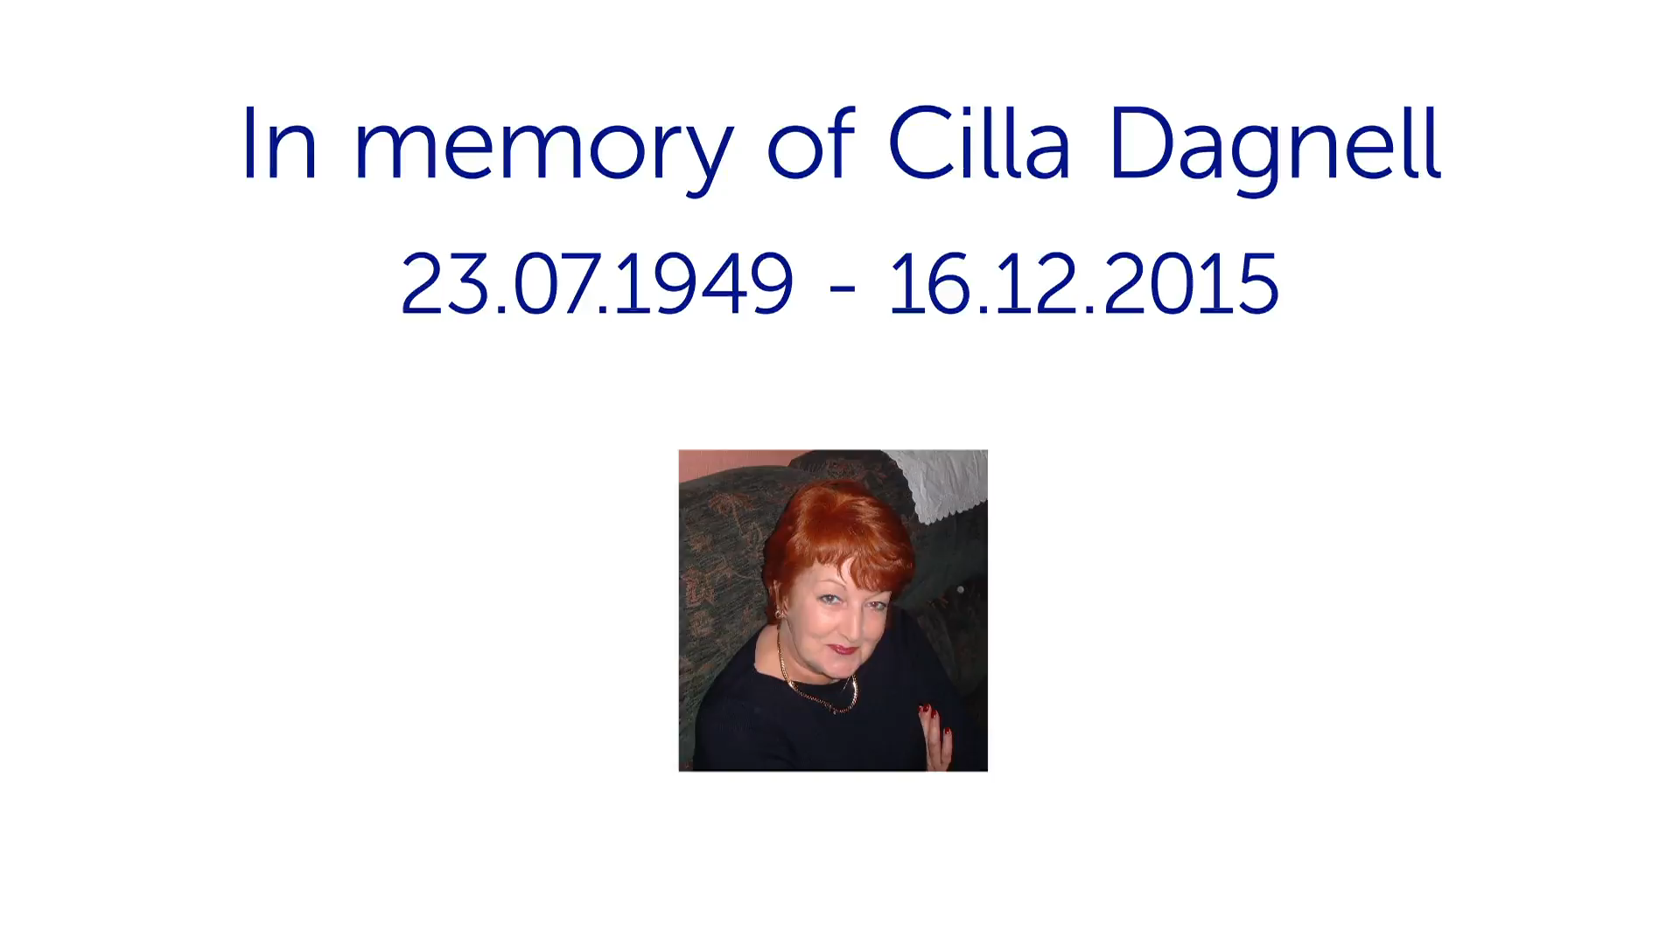
Notes:
I would to share a video now, some of you have seen it before.
Some of you attending may have seen few people with these conditions, this videos shows the progression of the condition and highlights the complexity of PSP. I would like to thank Cilla and Steve for letting us share this
Pause post video

Slide 15
What was our process ?
We came from mixed areas of specialism
We reviewed current evidence
Our opinion and expert knowledge
Notes:
We came from mixed areas of specialism, falls, rehab, palliative care.

Slide 16
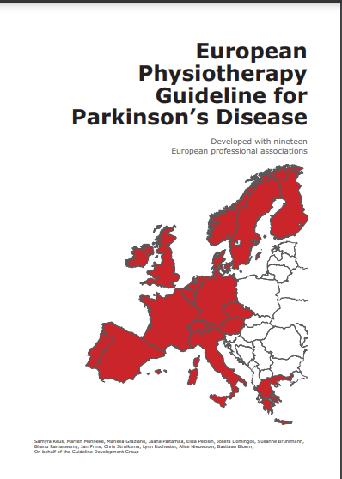


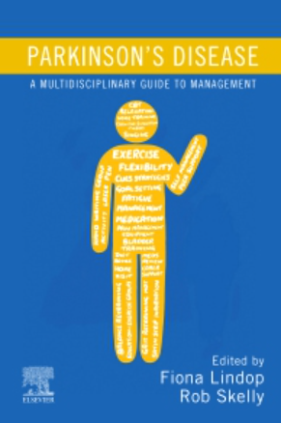
European Physiotherapy Guidelines for Parkinson’s Disease
PSPA OT Guide
PSPA Professional guide
Chapter 13 MDT management in APS
Notes:
What guidelines are there…

Slide 17
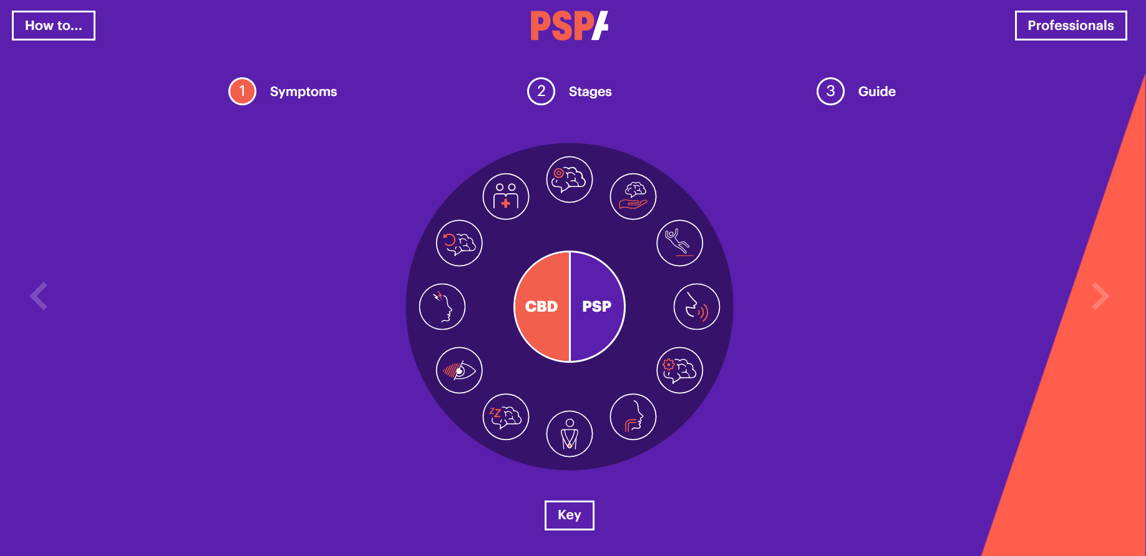

Slide 18
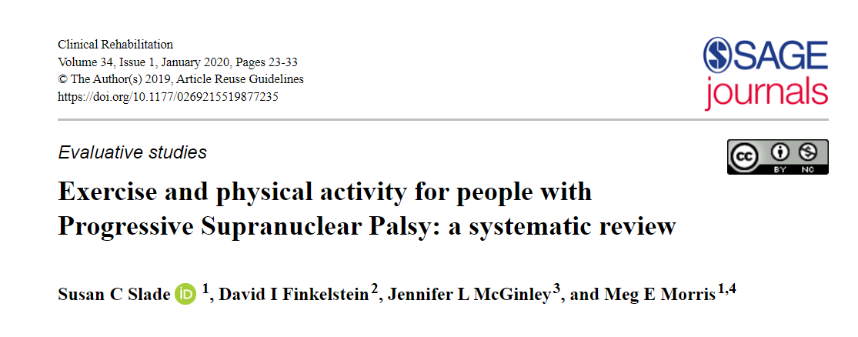
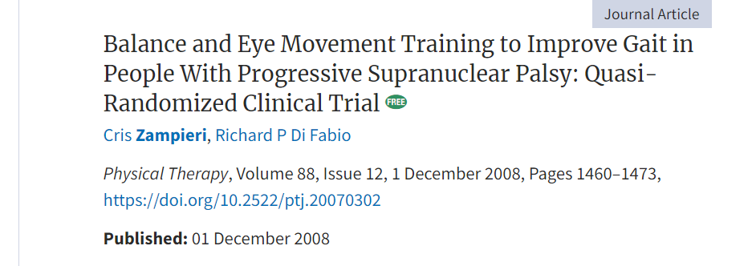
Evidence Base
Notes:
Slade review- robust evidence was not found for therapeutic exercises,
The effects of structured physical activity for people with advanced PSP is not known.
There is insufficient evidence that PD exercise interventions can be effective for people with psp.
Balance training may improve walking speed and quality.
Clerici et al (2017) looked at a multidisciplinary, intensive motor and cognitive goal based rehabilitation with either treadmill or gait robot. It was for 4/52 5/7 all 24 individuals improved in PSRS, 6 min walk and reduced number of falls.
Zampieri 2009 – Improved gaze control after balance and eye movement training.

Slide 19
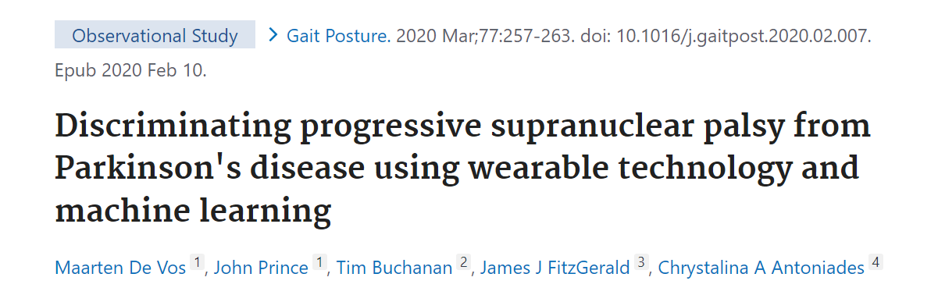
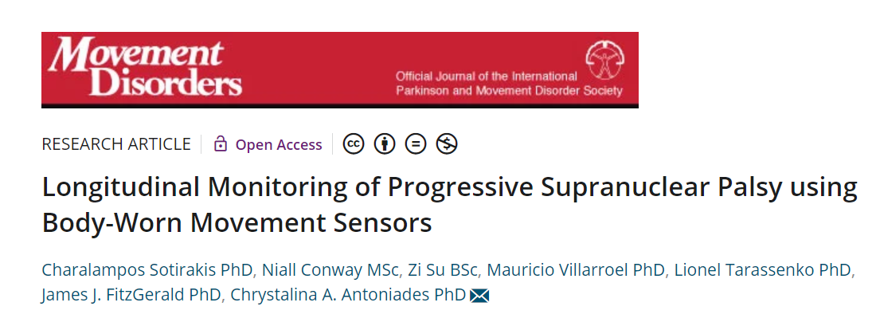
Discrimination of PSP from PD with 86 % sensitivity and 90 % specificity, and PSP from HC with 90 % sensitivity and 97 % specificity.
Progressive decrease in toe off angles is an indicator of decreased PF, leading to smaller propulsive torques when walking, resulting in smaller steps and decreased walking speed.
Notes:
Wearable technology was used to discriminate between PSP and PD. This was shown to both specific an dsensitive.
A later study looked at longitudinal monitoring of the condition, and this highlightd reduced pf impacting on smaller steps length and speed.
So you can see we are learning more about these conditions.

Slide 20
What is the benefit of these guidelines?
One stop guide for physiotherapists
Top tips sections
You can refer to the other guidelines for an expansion of information if required.
Evidence and research is constantly developing, as it does, so the guidelines we will be updated.

Slide 21
Notes:
So lets take a look!
It will be on line for you to download, I believe you will also be receiving a copy in the post.

Slide 22
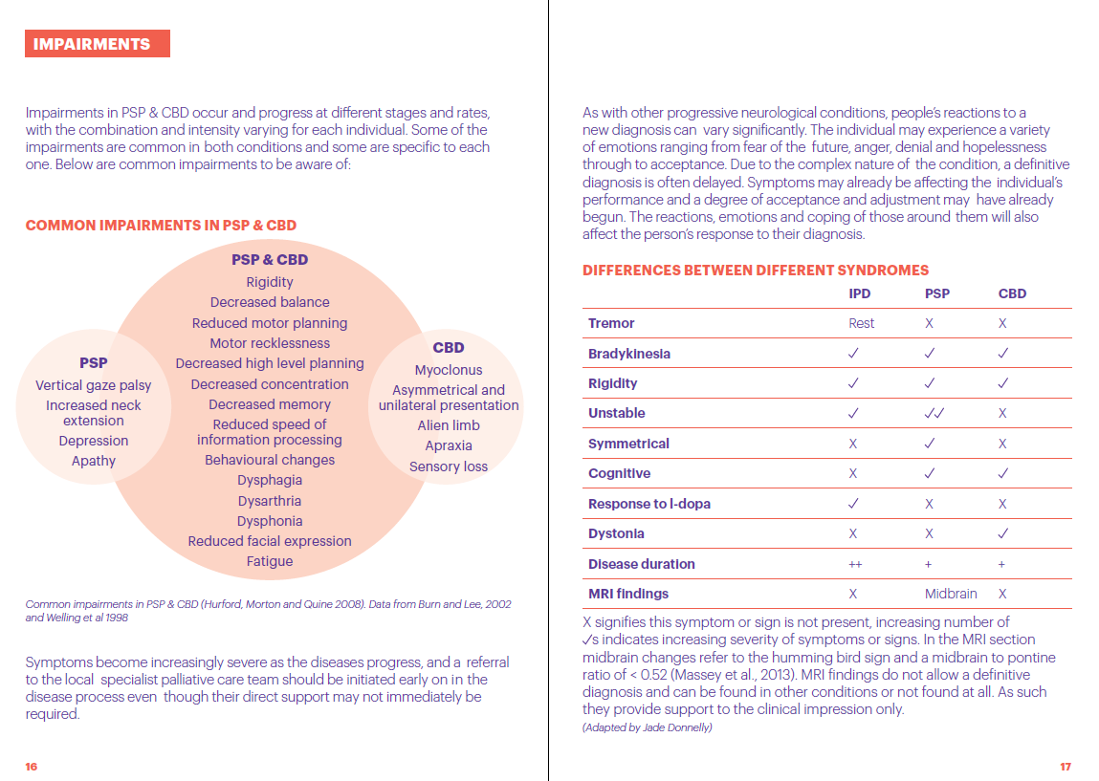
Notes:
So lets take a look…..
There is information about conditions, so that you can understand more about these conditions. Differences between other conditions, for example PD and PSP in quick reference tables.

Slide 23
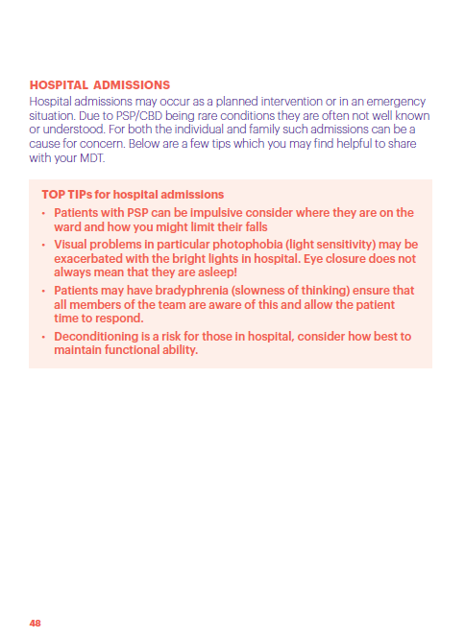
We have included top tips sections for easy quick referencing.
Notes:
We have included top
These are a quick reference guide if you want a quick read and rapid ideas or answers.

Slide 24
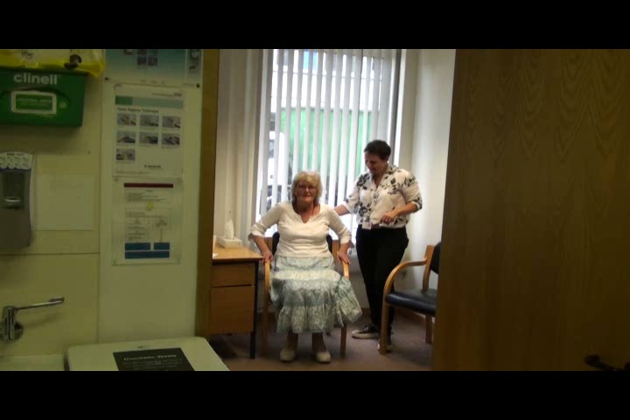

Sit to stand
Notes:
I think often there is a fear of complex neurological conditions. I believe that if you have an understanding of these conditions and the symptoms which present then hopefully we can dispel the fear.
To demonstrate this I would to show you 2 short videos.
No sound talk over it… say what you see
24

Slide 25
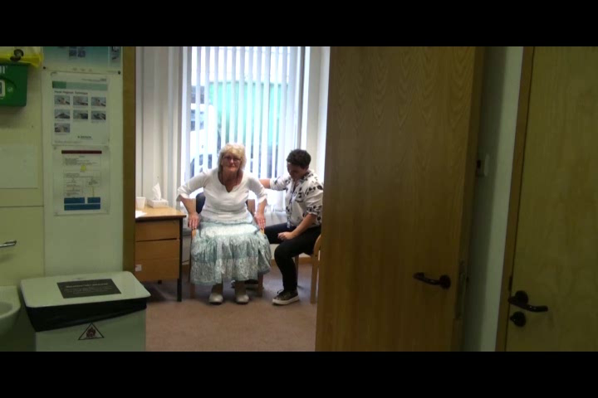
Notes:
As a physio ….As you can see movement is much quicker, more efficient.
AS a patient what does it mean ..
Get to the loo in time
But just 10mins isn’t enough, we need to educate carers on prompts so the effect can be reinforced and improved maintained.

Slide 26
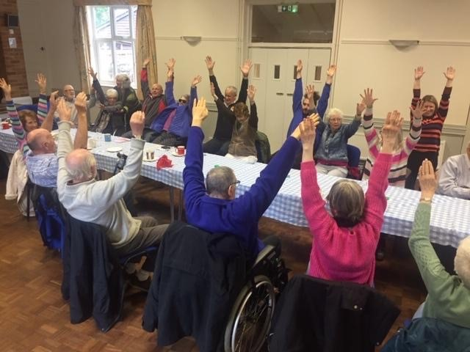
Questions ?
Notes:
No, your turn to ask us questions,
Thank you for listening.

Slide 27
Thank you for listening
Contact details:
Jade.Donnelly@uhs.nhs.uk
07824124626

