Slide 1



Progressive supranuclear palsy and Corticobasal syndrome
Dr David Whiteside
Clinical Research Associate and Honorary Neurology Registrar
Cambridge Centre for Parkinson-plus
Department of Clinical Neurosciences, Cambridge University
Cambridge University Hospitals NHS Foundation Trust
@CambridgeFTD
djw216@cam.ac.uk

Slide 2
Overview
A bit of terminology
Differences and overlap – the wider spectrum
The conditions and diagnosis
Management
Hope for the future
Many slides and videos here are courtesy of Professor James Rowe

Slide 3
Why PSP and CBS?
Prevalence >5 per 100,000 (cf MND)
Very low awareness & Commonly misdiagnosed
Very disabling, poor prognosis (median survival 5-6 years)
Cognitive dysfunction has a large impact on quality of life
Worth treating proactively

Slide 4
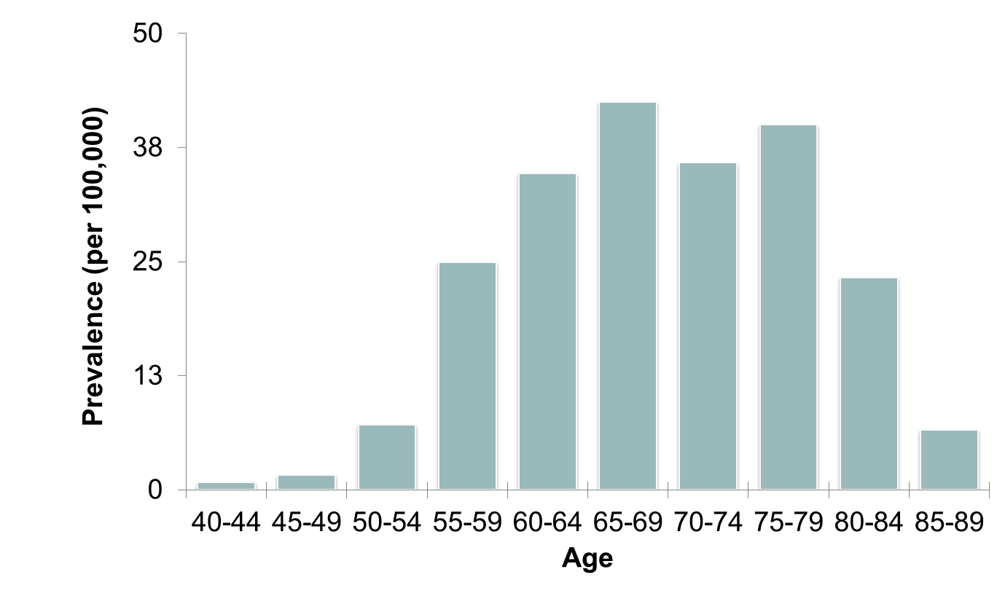
Prevalence (PSP/CBS)

Slide 5
Clinical syndrome v pathological findings – some terminology
Differentiate between terms used for the clinical syndrome:
Progressive supranuclear palsy (PSP) and Corticobasal syndrome (CBS)
And the neuropathological findings:
Progressive supranuclear palsy (PSP) and Corticobasal degeneration (CBD)

Slide 6
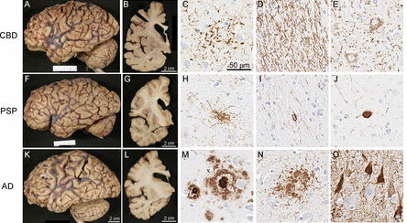
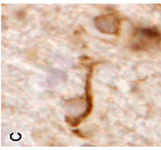
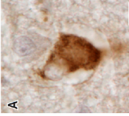
Neuropathology in PSP and CBD
‘Junk’
proteins
Connection
breakdown
Atrophy
Mild
signs
Disabling
Syndrome
4R TAU pathology
Koga et al, JNNP 2022
Notes:
In CBD, the characteristic findings include astrocytic plaques (C), numerous tau-positive threads in the white matter (D) and pretangles (E). In PSP, the characteristic findings are tufted astrocytes (H), oligodendroglial coiled bodies (I), and globose neurofibrillary tangles (J). In AD, the characteristic findings with tau immunohistochemistry are neuritic plaques (N) and neurofibrillary tangles (O), as well as amyloid-β positive amyloid plaques (M).

Slide 7
Environment
Inflammation
Gene
Aggregation
Spread
Cell death
Synaptic function
Neurotransmitters
Neural oscillations
Connectivity
Behaviour, Cognition
Survival

Slide 8
Behavioural
Variant FTD
Primary
Progressive
Aphasia
Armstrong et al 2013
Gorno-Tempini et al 2011
Litvan et al., 1996
Höglinger et al., 2017
Rascovsky et al 2011
Notes:
Although increased clinical and pathological fractionation of the FTLD disorders has led to the development of specific criteria to classify patients into distinct groups, there is substantial convergence of syndromes over time.

Slide 9
“Parkinson-plus”
Frontotemporal dementia
Progressive
Supranuclear
Palsy
Corticobasal
Syndrome
Behavioural
Variant FTD
Primary
Progressive
Aphasia
Armstrong et al 2013
Gorno-Tempini et al 2011
Litvan et al., 1996
Höglinger et al., 2017
Rascovsky et al 2011
Notes:
Although increased clinical and pathological fractionation of the FTLD disorders has led to the development of specific criteria to classify patients into distinct groups, there is substantial convergence of syndromes over time.

Slide 10
Frontotemporal dementia
Progressive
Supranuclear
Palsy
Corticobasal
Syndrome
Motor
Neuron
Disease
MND
Behavioural
Variant FTD
Primary
Progressive
Aphasia
Armstrong et al 2013
Gorno-Tempini et al 2011
Litvan et al., 1996
Höglinger et al., 2017
Rascovsky et al 2011
Notes:
Although increased clinical and pathological fractionation of the FTLD disorders has led to the development of specific criteria to classify patients into distinct groups, there is substantial convergence of syndromes over time.

Slide 11
Frontotemporal dementia
Progressive
Supranuclear
Palsy
Corticobasal
Syndrome
Motor
Neuron
Disease
MND
Behavioural
Variant FTD
Primary
Progressive
Aphasia
Alzheimer’s
Dysexecutive
& logopenic
variants
Armstrong et al 2013
Gorno-Tempini et al 2011
Litvan et al., 1996
Höglinger et al., 2017
Rascovsky et al 2011
Notes:
Although increased clinical and pathological fractionation of the FTLD disorders has led to the development of specific criteria to classify patients into distinct groups, there is substantial convergence of syndromes over time.

Slide 12
PSP
CBS
AD
variants
bvFTD
PPA
MND
Armstrong et al 2013
Gorno-Tempini et al 2011
Litvan et al., 1996
Höglinger et al., 2017
Rascovsky et al 2011
Notes:
Although increased clinical and pathological fractionation of the FTLD disorders has led to the development of specific criteria to classify patients into distinct groups, there is substantial convergence of syndromes over time.

Slide 13
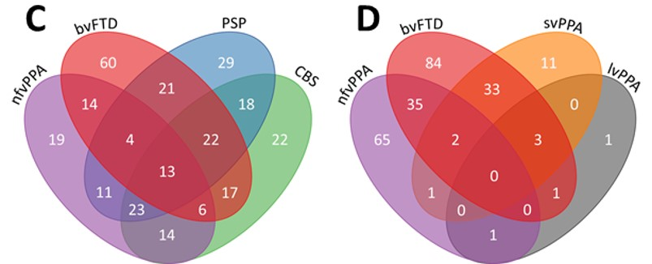
Patients have features of multiple diagnoses
(if you remove the mutual exclusivity clause)
Consensus clinical diagnosis criteria symptoms/signs:
bvFTD – Rascovsky 2011; nfvPPA, svPPA – Gorno-Tempini 2011
PSP – MDS-PSP 2017; CBS – Armstong 2013

Slide 14
Patients may have features of multiple diagnoses
Sometimes it is more important to look at the individual symptom

Slide 15
Progressive supranuclear palsy

Slide 16
Diagnosing ‘classical’ PSP
PSP-Richardson’s syndrome, PSP-RS, “classical PSP”
Probable PSP-RS if
1. sporadic, progressive, onset >40 years
2. vertical gaze palsy (restriction OR slowing)
3. unprovoked falls or tendency to falls (<3 years)
→ highly specific, not very sensitive
→ reliable and easy in clinical practice
Steele, Richardson, Oslewski ‘64, Litvan 96, Hoeglinger et al, Mov Disord 2017

Slide 17
What symptoms predict PSP vs CBD, MSA, PD, bvFTD
Respondek et al Mov Dis 2017
Supranuclear gaze palsy – especially <3years
Postural instability – especially <1 year, <3 years
Akinetic rigidity if axial and levodopa resistant
Non-fluent <3 years (differential FTD/PPA)
Dysarthria, dysphagia < 3 years

Slide 18
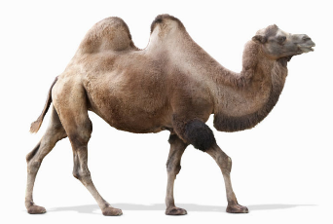
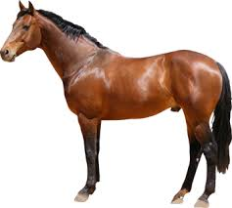
PSP versus PD
 | PSP | PD
Symmetrical | Yes | No
Rigidity | axial | limb
Akinesia | Severe, axial Even in loose limbs | Mild to moderate
Tremor | No | Yes
Falls | Early, spontaneous | Late, with freezing
Eyes | Abnormal | ‘normal’
Voice | Dysarthrophonia, distorted, volume control | Hypophonia Quiet
Cognition | Marked early changes Loss of fluency | Later dementia
Levodopa | Poor response | Very good response
Gait | Head up, sniffing the air Leaning back | Head down, stooped, leaning forward
Looks like PD? | No | Yes

Slide 19
2017 criteria
Cognitive and behavioural variants
50% of PSP
PSP-F (frontal)
PSP-SL (speech & language)
PSP-CBS (corticobasal)
.

Slide 20
Impulsivity - physical and mental
  Cramming food
  Cannot tolerate delay
  Cant suppress a habitual response

Slide 21
Apathy:
Common – frustrating – harmful
  Its about motivation and effort and function
  It is not Depression
    Most PSP patients will say that they feel well
    Low mood is not common
  It is not Akinesia/bradykinesia
    But can look like it.
    Most patients can enjoy things, but lack motivation

Slide 22
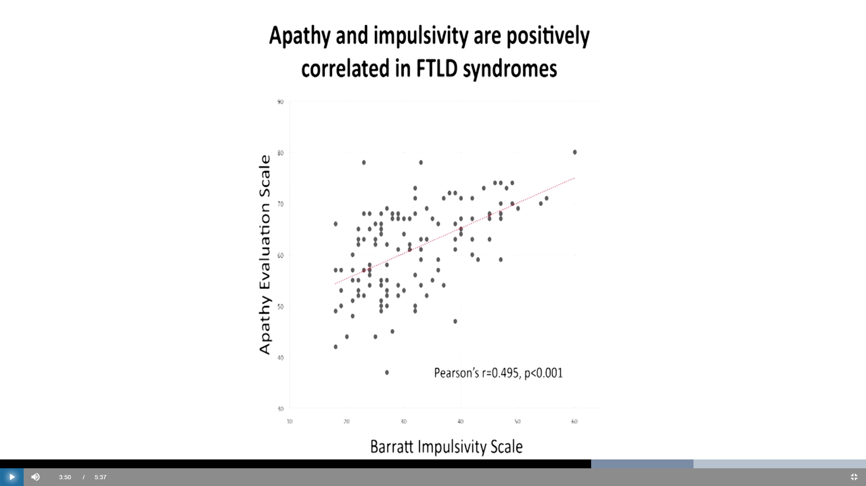
PSP - apathetic AND impulsive
PiPPIN 1
Lansdall et al Brain 2017

Slide 23
PSP and FTD-PSP overlap
Challenging behaviour, irritability and aggression
  5 – 20% of patients
  (Aarsland et al., 2001; Bak et al., 2010; Litvan et al., 1996e).
  less than in Alzheimer’s disease, similar Parkinson’s disease
Overlap with Frontotemporal dementia
  Some patients with bvFTD develop PSP-like signs
  Some patients with PSP develop severe disinhibition, loss of empathy, hyperorality, apathy and executive dysfunction (cf. bvFTD)

Slide 24
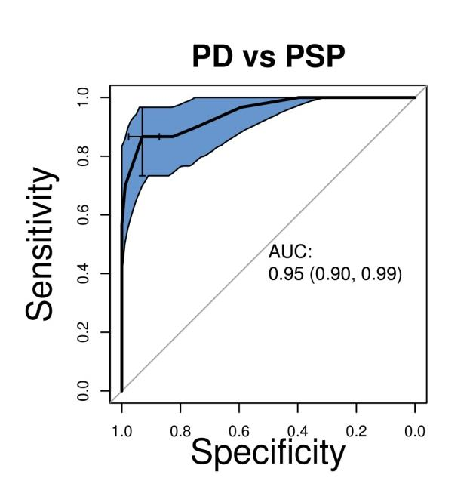
Quick bedside test = Verbal fluency
Seven P-words/minute
~95% accurate to distinguish PD from PSP
Rittman et all JNNP 2012

Slide 25
Psychiatric comorbidity: most patients with PSP feel well, and describe themselves as happy
Depression exists, not universal, avoid assumptions
symptom overlap (apathy, weight loss, sleep change)
reduced sensitivity to emotion expression
Emotional incontinence without depression
And poor agreement on the rates of depression:
20 % moderate to severe (Millar et al Movement Disorders 2006)
vs
100% moderate depression (Herting et al Movement Disorders 2007)
-> focus on patient
(sad, low, helpless, anxious, crying/unable to cry, suicidal)

Slide 26
PSP variants
Pure gait freezing (pure akinesia gait freezing)
Other oligosymptomatic PSP prodromes
isolated gaze palsy
Adynamic speech, non-fluency
Cognitive prodrome
PSP-parkinsons (PSP-P):
psp pathology but looks like PD
a retrospective diagnosis (post mortem or
after the illness becomes PSP-like)

Slide 27
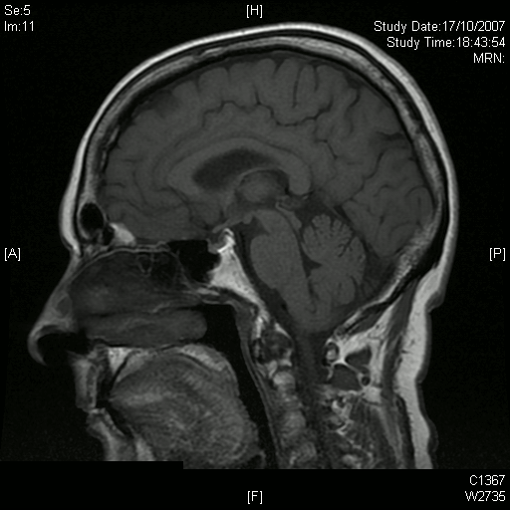
Midbrain atrophy

Slide 28
Current healthcare Imaging to exclude other pathology
Hydrocephalus, NPH
Vascular dementia
Multi-system atrophy
→ Dementia +- slowing, +- parkinsonism, +- oculomotor disorders +- falls…
.

Slide 29
Progression and staging
Key milestones (Golbe et al 2020)
Swallowing difficulties
Severe speech disturbance
Severe gaze palsy
Severe postural instability
Severe bradykinesia
Cognitive impairment
Death
PSP rating scale is a good predictor of time to reach these milestones
Staging tools exist (e.g. Golbe et al 2020) but are not commonly used in clinical practice

Slide 30
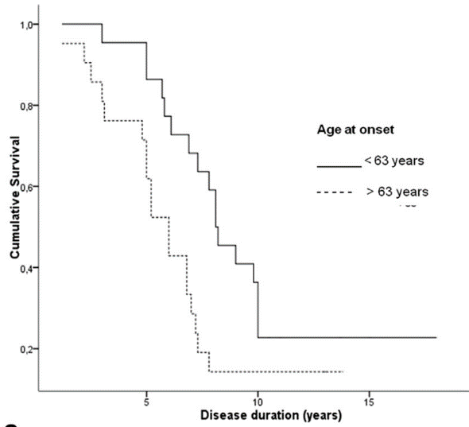
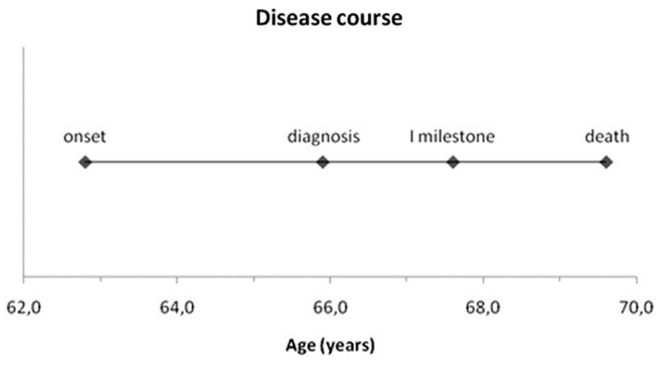
Survival
  From onset to median death 5-7 years
From onset to diagnosis ~3 years
Cumultaive survival
0 5 10 15 years
Dell’Aquila et al 2013
But all major US and European studies similar

Slide 31
Corticobasal syndrome

Slide 32
Corticobasal syndrome (=clinical disorder)
& Corticobasal degeneration (=neuropathology)
“Classical CBS”:
1. Progressive and Asymmetric
2. higher cortical functions – apraxia, cortical sensory loss, alien limb
also non-fluent aphasia, loss of grammar, visuospatial deficits
3. Movement disorder – dystonia, focal myoclonus, akinetic-rigidity +/- mirror movements

Slide 33
CBS vs CBD
Syndrome vs pathology
progressive non-fluent aphasia
PNFA/nfvPPA-like
later motor deficits
CBD
CBS
useless arm
Rigidity
Dystonia
Akinesia
apraxia
alien limb
myoclonus)
‘AD-like’ syndrome
memory impairment
visuospatial dysfunction
Disorientation
PSP-like syndrome PSP-like pathology

Slide 34
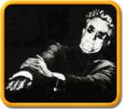


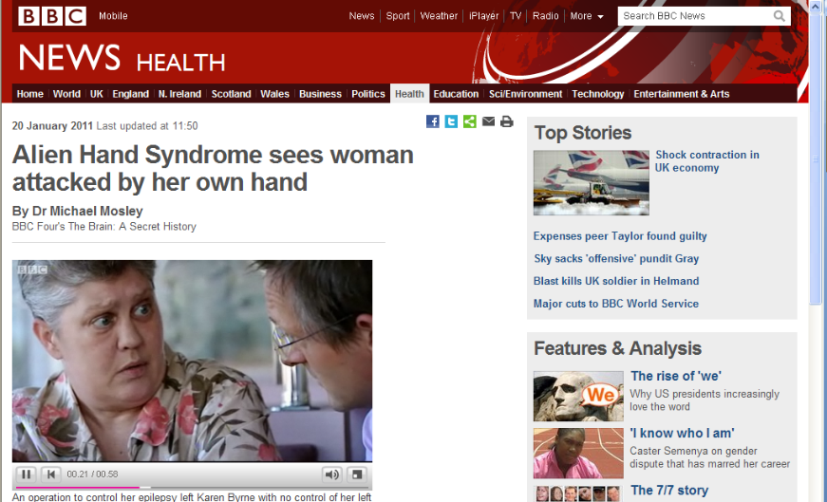
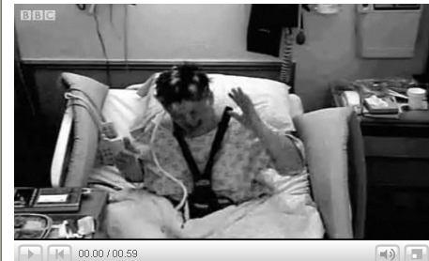
Alien limb
Levitation
Face touching
Interference
Complex tasks
Not delusions of control
Dog food and coins

Slide 35
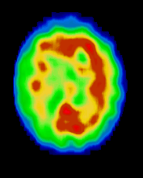
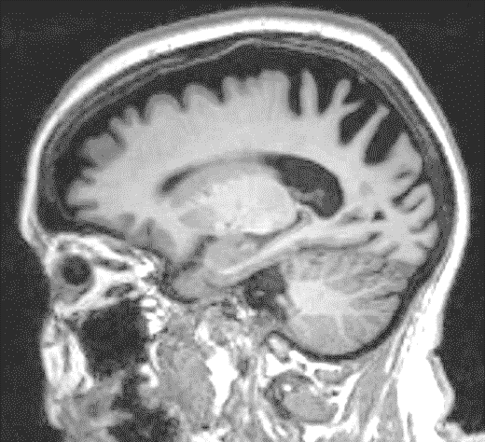
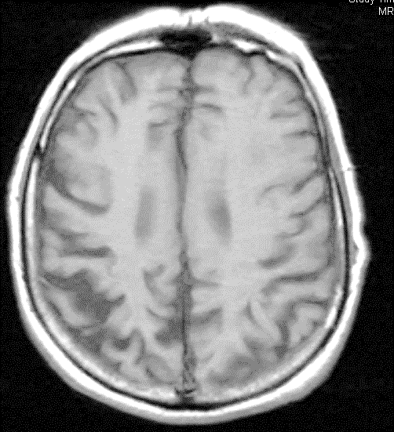
Neuroimaging in Corticobasal Syndrome
MRI: NHS: Global atrophy (mild) and lateralised parietal atrophy (common)
SPECT: asymmetric parietal hypometabolism (+occipital, +frontal, +temporal)

Slide 36
Other investigations
May consider lumbar puncture to confirm/ support diagnosis of Alzheimer’s Disease as cause of CBS
New blood tests coming for Alzheimer’s disease

Slide 37
Management of PSP/CBS

Slide 38
Autonomy and Control
Most patients retain mental capacity
Communication is slow and difficult
  But that’s our problem, not the patients
For many patients, the biggest problem is being ignored: multifactorial
“To whom it may concern…” letters

Slide 39
Symptomatic Treatments 1 - Motor
Akinetic-rigidity:
  Sinemet/madopar – rapid escalation, taper if ineffective
    Poor response does not mean no response
    A partial response for 1-3 years is worth it
    Levodopa does not cause dyskinesia in PSP (it is not PD after all)
  Amantadine – for motor symptoms and non-motor
    ~60% response, esp. young mild cases (mixed domains)
Pain/dystonia/retrocollis
botox injection eg. paraspinal muscles, finger flexors
Lid apraxia and blepharospasm –
Botox – may indirectly help falls
Myoclonus – clonazepam or levitiracetam good, but not valproate

Slide 40
Symptomatic Treatments 2 – Mood
Depression (don’t make assumptions about mood)
SSRIs – citalopram (liquid via peg or if dysphagic)
mirtazepine – appetite and weight gain useful
Avoid tricyclics (amitritylline) - side effects, drowsy, falls
Emotional incontinence – low dose citalopram (SSRI)
.

Slide 41
Symptomatic Treatments 3 - other
Urology or Neurology –
non-drug treatments mainstay
drugs – 5HT3 (Mirabegron) rather than ACh (oxybutynin)
Sleep
address root causes, anxiety, pain, sleep-hygiene etc
get the bladder right first
BZPs, melatonin,
Amnesia (CBD) cholinesterase inhibitors (often AD)
Visuospatial – ophthalmology review, (CBD) register as sight impaired

Slide 42
Symptomatic Treatments 4
Palliative care:
planning and reassurance,
open discussions (the patient
is way ahead of you on this)
Some fears are easy to allay
Risk benefit (eg opiates)

Slide 43
Symptomatic Treatments 5
Cognitive and personality change
inclusive of family & carers
mainly non-pharmacological
personalised

Slide 44
Symptomatic Treatments 6 – psychosis
Psychosis
  rule out infection, infection or infection
  look to your medications – amantadine, cholinergics, opioids
  question the diagnosis

Slide 45
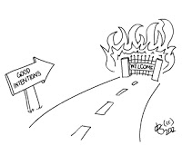
Harm avoidance
Catastrophic harm from neuroleptics
  Severe, irreversible, unnecessary
  Haloperidol >> risperidone >> quetiapine
Moderate risk
  Cholinergics for bladder
  Tricyclics
  Opiates for pain
  Fosamax in dyphagia
  …..

Slide 46
Multidisciplinary Team
PSP Association (www.pspassociation.co.uk)
Speech and language therapy
speech and other forms of communication
swallow assessment, treatment (thickeners, diet, peg.)
PEG - timing critical
Dietician- weight loss is a bad sign in PSP
Palliative care team and Gold Service Framework
Physiotherapy – falls and rising
Occupational therapy – must keep up to date with progressive disability
Community matron & Team
Financial & Legal
Power of Attorney, advance directives/preferred place of care, driving, benefits

Slide 47
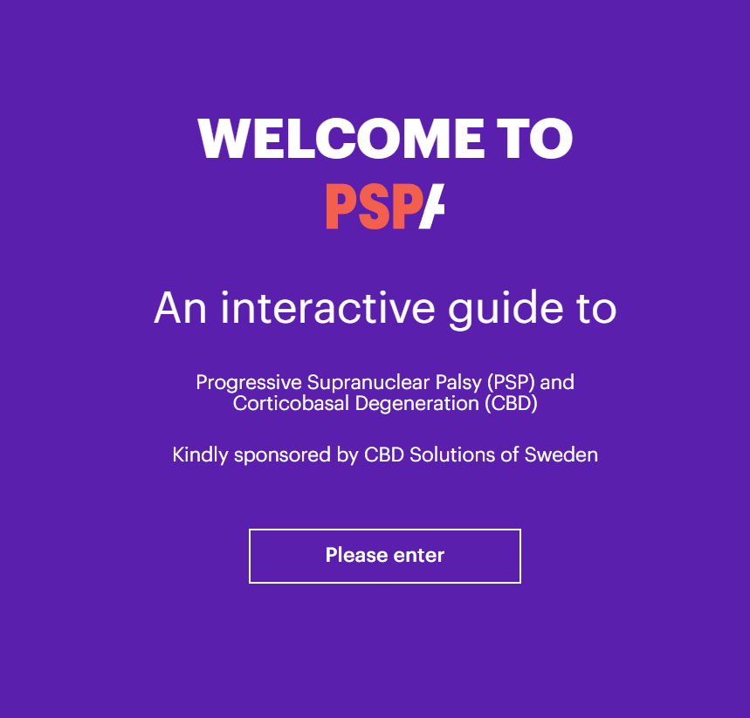
https://hscpguide.com/step/symptoms

Slide 49
The future in PSP and CBS

Slide 50
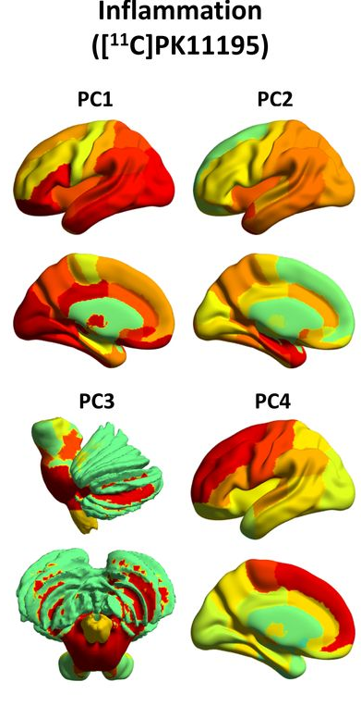
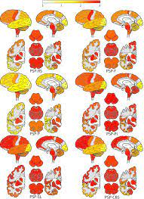
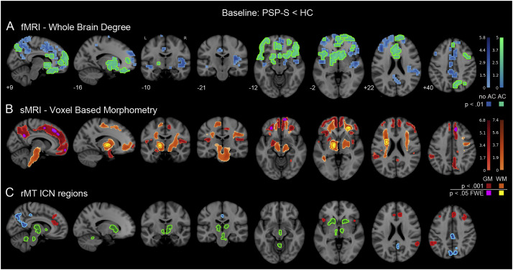
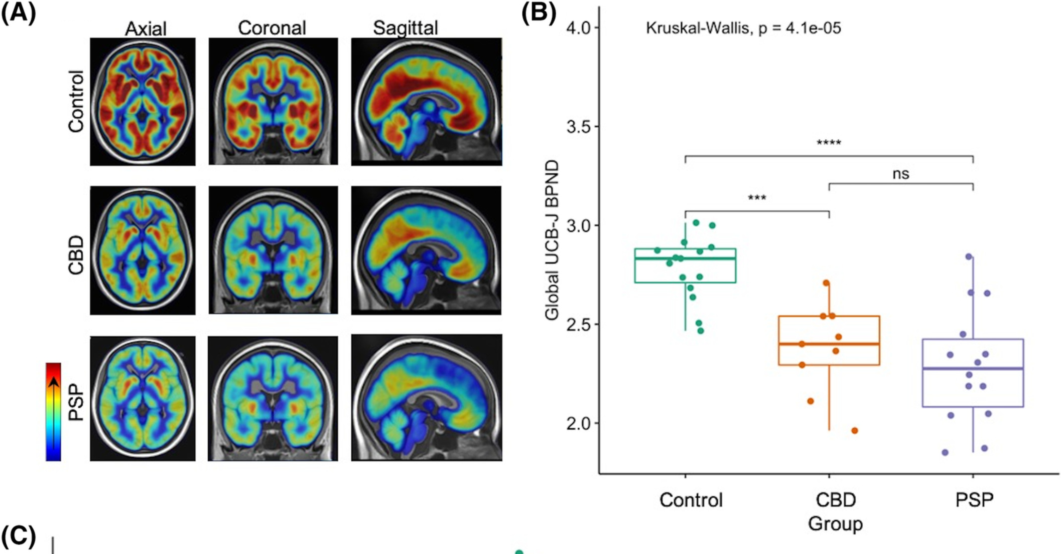
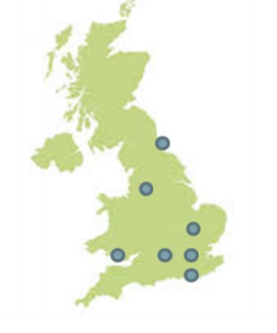
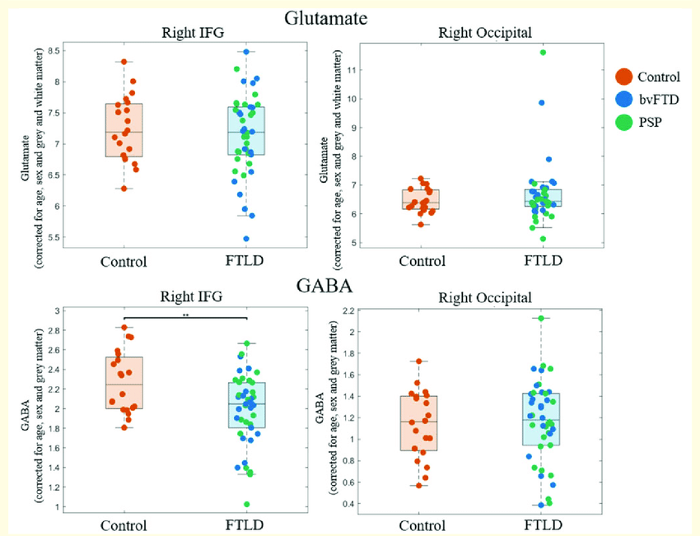
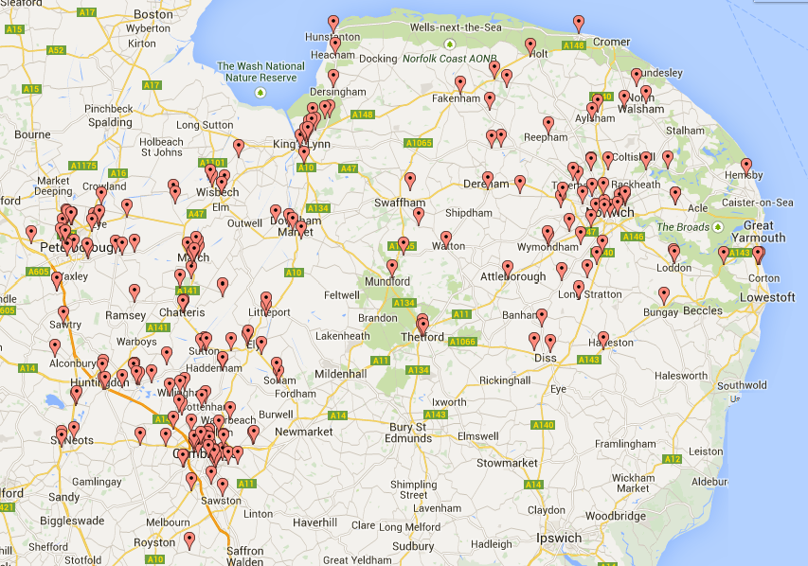
We’ve learnt a lot about PSP/CBS in the past two decades
Kovacs et al 2020
Passamonti et al 2018
Malpetti et al, 2021
MAPT FLNA
LRRK2 STX6
MOBP TREM2
e.g.
Tsujikawa et al 2021
Jabbari et al 2021
Environment
Inflammation
Gene
Aggregation
Spread
Cell death
Synaptic function
Neurotransmitters
e.g Brown et al, 2017
Neural oscillations
Connectivity
Behaviour, Cognition
Holland et al 2020
Survival
PROSPECT
Jabbari et al, 2019
Murley et al 2020
Coyle-Gilchrist et al, 2016

Slide 51

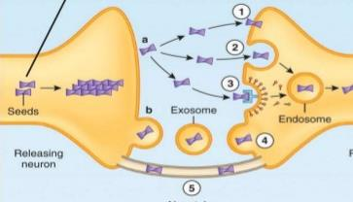
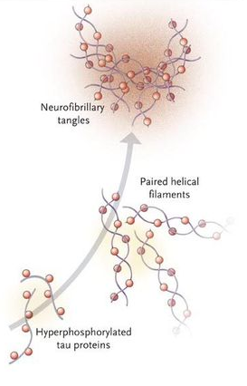
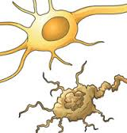

Disease modifying therapy
Clearance
Cell to cell spread in the brain
Cell death
Tolerance
Aggregate
Toxic
fibrils
Sticky

Slide 52
Challenges in developing disease modifying drugs
Diagnosis often delayed – new criteria may be helpful
Choosing the right target
No easy way to confirm underlying pathology in lifetime
Wide range of symptoms – targeting the right outcome

Slide 53

Improving management and symptom control
Earlier diagnosis
Better access to information and support
Improved access to therapy
Trials and research into symptomatic treatments

Slide 54
Summary
Active management and early diagnosis are vital in PSP and CBS
Need input from the whole of the MDT
Lots of overlap and variety in symptoms and progression
Hope for the future
Thanks to all patients and carers at the Cambridge Centre for Parkinson-plus, Professor James Rowe and Dr Tim Rittman

