Slide 1
Speech and Language Therapy: PSP/CBD
Caroline Jeffries-Shaw
Principal Speech and Language Therapist
Croydon Health Services NHS Trust
Carolinejeffries-shaw@nhs.net

Slide 2
Aims of Presentation
Outline communication difficulties seen in PSP/CBD
Outline swallowing difficulties seen in PSP/CBD
Case presentation

Slide 3
Communication Difficulties
Mixed dysarthria: hypokinetic and spastic/ataxic types
Slurred/imprecise articulation
Fast rate of speech or…
Slow monotonous speech; slow rate and reduced pitch, intonation, stress
Strained/hoarse voice quality; characterised by a quiet, strained voice with occasional explosions of a louder voice
Hypophonia: low volume or breathy quality
Palilalia > Echolalia

Slide 4
Communication difficulties cont…
Less studies on the language changes seen
However,
Reduced verbal fluency and word finding difficulties evident
Syntactic structures remain intact generally but less information/content is used by the person with PSP/CBD
Cognitive changes impact on persons ability to initiate communication, reduced memory to recall information

Slide 5
Factors affecting assessment
Regular monitoring to enable suitable adaptations to be put in place
Consider barriers to assessment:
Cognitive changes
Delayed/slowed processing and response times
Visual difficulties; supranuclear gaze palsy, blurred vision and diplopia
Fatigue/pain
Mood changes; depression, apathy and reduced initiation

Slide 6
Intervention approaches
Direct therapy such as Lee Silvermann Voice Therapy (LSVT)
Communication partner training
AAC – consider this early on to increase acceptance to both the person with PSP/CBD and their support network
Voice banking

Slide 7
Swallowing difficulties – signs/symptoms
Coughing/choking when eating or drinking
Wet/gurgly voice when eating or drinking
Chest infections
Weight loss
Impulsive eating behaviours; eating too fast/over filling the mouth
Taste changes are reported: tendency to prefer sweet foods
Difficulty with the person feeding themselves due to reduced downward eye gaze

Slide 8
Assessment of Swallowing Difficulties
Bedside assessment considering:
Different textures/types of fluid
Ability to self-feed
Time taken to eat/drink
Instrumental assessment
VF/FEES
Can provide biofeedback to client/family to aid decision making

Slide 9
General Advice re Swallowing difficulties
Aim to: reduce chest infections/weight loss/choking
Positioning: upright in midline
Small mouthfuls/slow, single, small sips
Slow pace for all oral intake
Modify food and fluid texture
Avoid challenging foods, e.g., stringy, fibrous, mixed textures
Supervision to prompt slow pace and assist with hand to mouth feeding

Slide 10
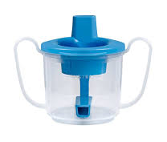
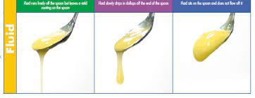
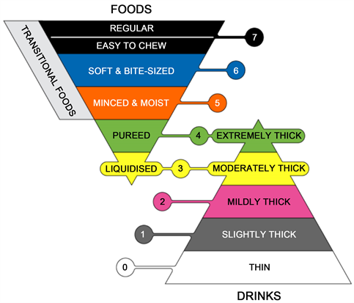
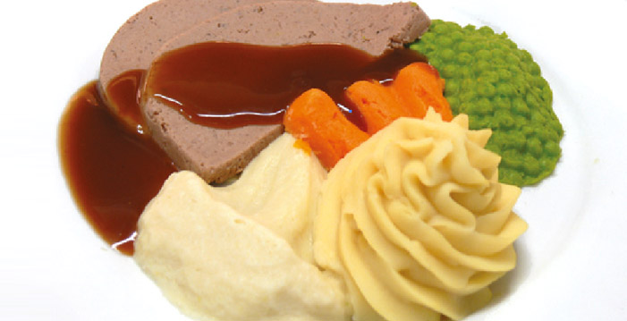
Diet/Fluid Modifications

Slide 11
Alternative nutrition/hydration
To PEG or not to PEG
Discuss early with the person and support network to gain insight into their wishes
Involve MDT early; gastro team, dietetics, neurologists
Document in ACP
Give information: mytube.mymnd.org.uk

Slide 12
Case History: GI
Patient GI (male) referred at age 68 to SLT, working diagnosis of PD
Previous CVA, Type 2 diabetic
Approximately a year later diagnosis of PSP made
Social History; wife (qualified carer), 2 children (one a GP), 2 grandchildren
Initially therapy focussed on SLOP strategies:
Slow
Loud
Over articulate
Pause

Slide 13
GI cont …
Development of alphabet chart and frequent use phrases specific to client.
Assessment for IPad with text to speech app
Go Talk device provided to enable participation in church meetings
Initially diet and fluid modifications implemented
Dislike for thickener++
PEG fitted in 2018 approx. 1 year after PSP diagnosis made
SLT/Dietician worked closely as complications with blood sugars

Slide 14
Questions

Slide 15
References
Communication impairments in people with progressive supranuclear palsy: A tutorial. Kim, J & McCann, C Journal of Communication Disorders 56 (2015) 76 -87
Language impairment in progressive supranuclear palsy and corticobasal syndrome. Peterson, K, Patterson, K and Rowe, J. Journal of Neurology 2021; 268 (3): 796 – 809
IDDSI: International Dysphagia Diet Standardisation Initiative 2019 (iddsi.org)

