Slide 1
PSP&CBD Research update
Annalisa Casarin, MD MPH
PSPA Research coordinator
October 2022

Slide 2
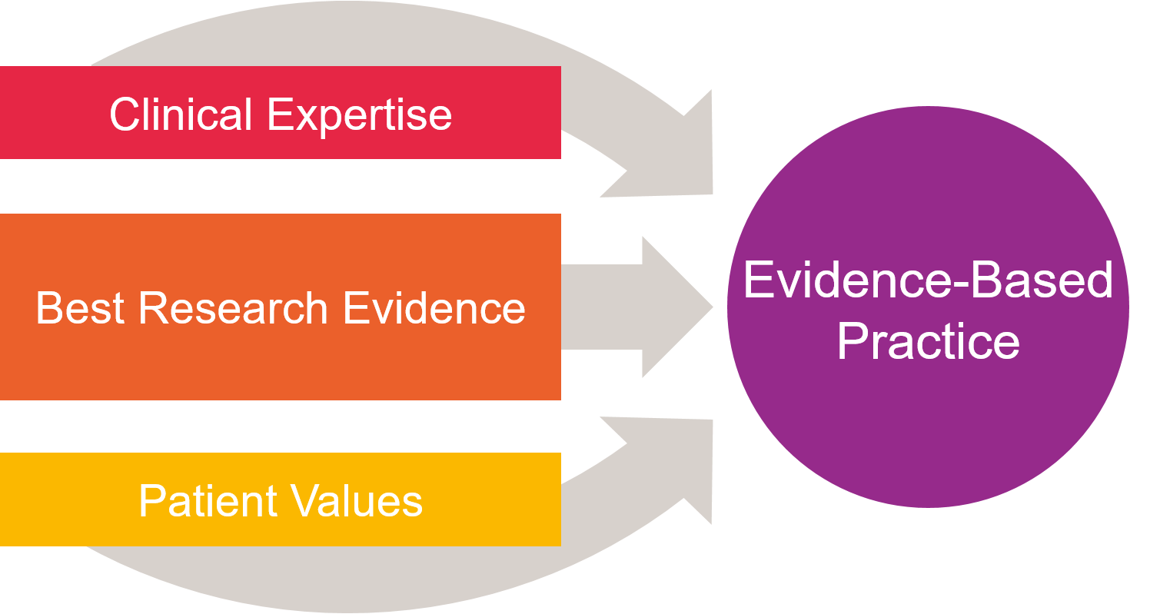
What is Research
It is the process of discovering new knowledge
It leads to development of new concepts or the advancement of existing knowledge and theories
…and to a new understanding of what was not previously known

Slide 3
Basic research is the study of life processes (biological, molecular, and chemical) that are universal in their application to scientific knowledge. Translational research: from the laboratory into the clinic [bench to bed] Clinical research addresses important questions of normal function and disease using human subjects. •Causes – what contributes to someone getting this condition? • Diagnosis – what can we measure to tell us whether someone has a condition? • Treatments – what medicines can we try to improve or resolve symptoms? • Outcomes – what will happen to a person with a condition? • Prevention – what can we change to stop someone developing this condition?
Different from Service evaluation and Audit

Slide 4
Other types of research
Observational – ‘watch and learn’
Researchers study groups of patients to find out more about a condition
Interventional – ‘test something new’
Researchers study how a new treatment or device compares with current treatments or a placebo
Systematic reviews
Health data research on already collected data
Purely Qualitative research
Economic Evaluation
Implementation science
Quality improvement

Slide 5
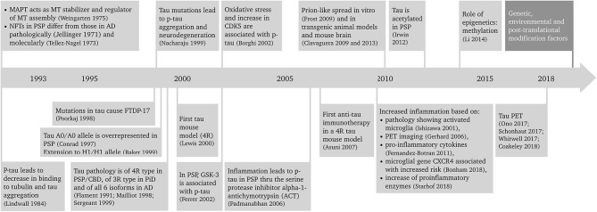
Twenty-five years of progress in PSP/CBD research doi: 10.3389/fneur.2019.01125

Slide 6
The PSPA Research Strategy 2020-2025
The strategy comprises of four strategic elements identified from the consultation with patients, carers, clinicians, researchers and organisations with a link to PSP and CBD.
1. Prioritising PSPA Research
Supporting new research ideas in a responsive manner
Supporting five research themes and targeting research in areas of high priority which encompass:
Prevention and causes
Awareness and education
Improved diagnosis, reduced misdiagnosis
Drug discovery and targeted treatments for the underlying causes
Improved interventions for the treatment of the all the symptoms of the conditions
All five research themes should enable a patient to live the best they can with
PSP and CBD
2. Research Stars of the Future
Growing new talent and new expertise, and creating the
“research stars of the future”
Supporting the rising stars in research to become the academics of the
future who will lead the way in finding treatments, improving diagnosis
and care for people with PSP and CBD in the next few decades.

Slide 7
The PSPA Research Strategy 2020-2025 -cont.
3. Patient Engagement in Research - Supporting research which reflects patient views and priorities, and encouraging and enabling anyone who wants to engage with our Take Part in Research Programme, giving them a Patient and Carers Voices in Research. - Educating members by working with local groups about PSP and CBD - Supporting the helpline team in answering member enquiries and providing research information and answering scientific questions - Working with pharmaceutical patient advocacy teams to encourage patient engagement in clinical trials 4. Communication, Collaboration and Change - Communicating research – bringing research findings to the people affected by PSP and CBD, our supporters and funding partners - Working with research institutions, charities, medical and health associations such as the Neurological Alliances, AMRC and ABN, and other overlapping health related charities to lobby government agencies and NHS commissioners for changes in clinical provision and pathways for people with PSP and CBD

Slide 8
What PSPA Funds
Small grants
MDTs Southampton
2 new applications
Project grants
Fellowship
Partnership with Scottish ABN
Topics - we asked patients! Research Information Day 2021 poll:
Types of research you would be interested in taking part in
66% Finding treatments
22% Improving quality of life
11% Early Diagnosis
Research priorities
Treatment
Misdiagnosis
Prevention
Improved care
Mobility & exercise

Slide 9
Progressive Supranuclear Palsy and Corticobasal Syndrome
October 2022
Notes:
Introduction

Slide 10
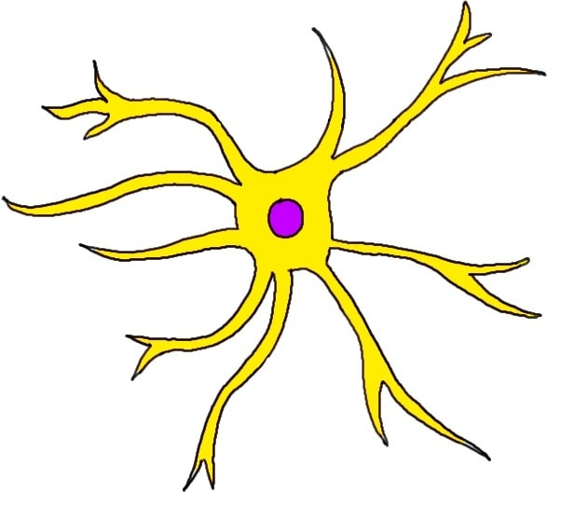
What are PSP & CBS?
Atypical parkinsonism
It’s all about tau
PSP & CBS – what’s the difference?
Differing symptoms between groups and individuals
Full understanding the conditions have not yet been achieved
CBD
PSP

Slide 11
PROSPECT-M-UK study programme
PROgressive SuPranuclEar Palsy CorTico-Basal Syndrome Multiple System Atrophy Longitudinal Study UK
The largest study of PSP&CBD globally
Current recruitment status: 1250 PSP/CBS/APS/MSA patients
Several streams:
Longitudinal and cross-sectional arms
Imaging
Biobank
Outputs: publications of more than 20 articles
Data analysis on 1001 people demonstrated a seminal finding on the association between a specific gene mutation and survival in PSP http://dx.doi.org/10.1016/s1474-4422(20)30394-x4
Genetic mutations and spinal fluid markers have been identified for CBD and they could help early diagnosis
http://dx.doi.org/10.1136/jnnp-2018-3201517

Slide 12
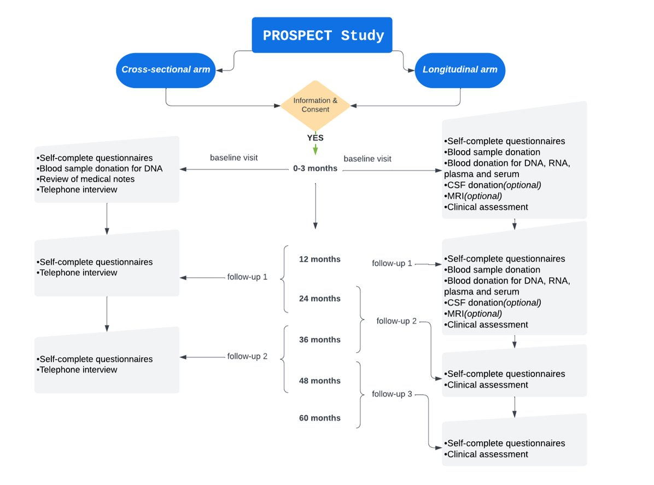
What does the study involve?

Slide 13
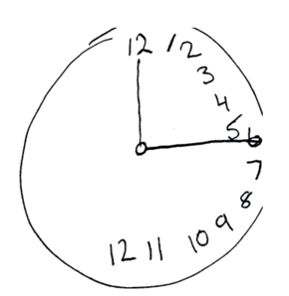
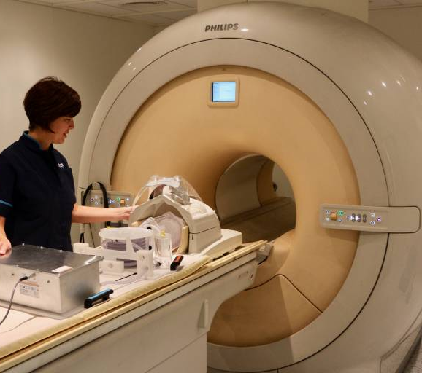
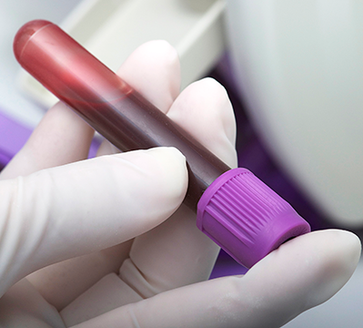
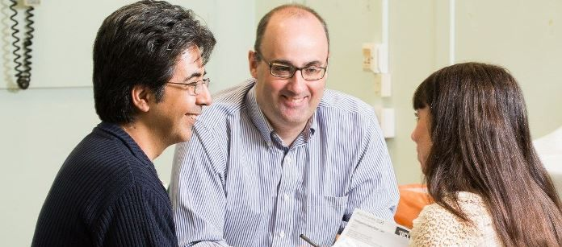
A PROSPECT Study Visit
Queen Square Institute of Neurology
© UCL
© UCL
© GAB13
© UCL

Slide 14
How will PROSPECT impact the future?
What’s in it for the patients/carers?
Understanding of the disease and developing a drug to treat and cure PSP and CBS
Future clinical trials
https://www.ucl.ac.uk/ion/research/research-centres/movement-disorders-centre

Slide 15
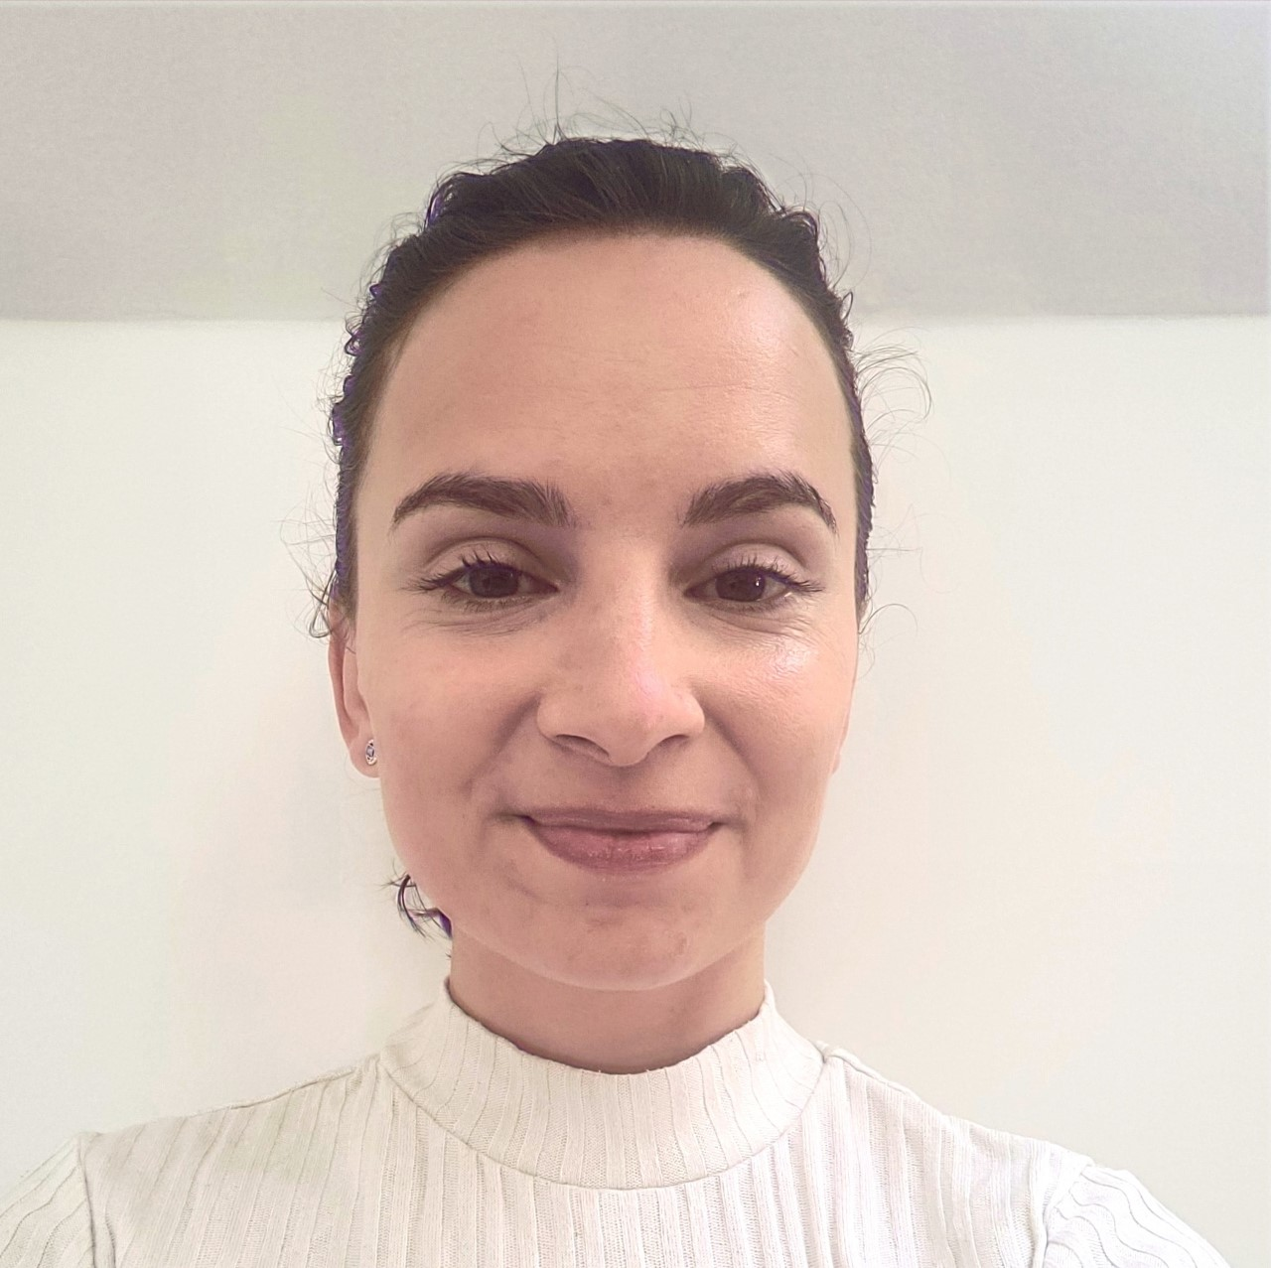
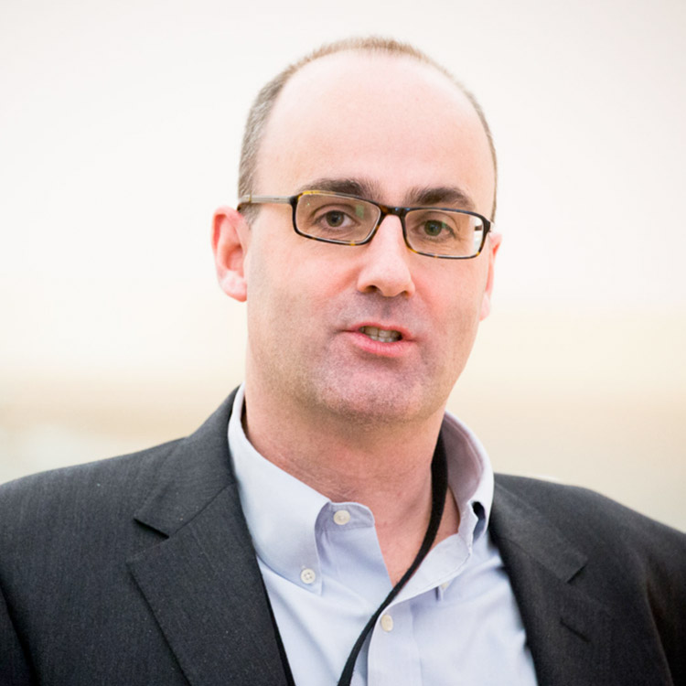
How can I get involved?
PROSPECT email: prospect@ucl.ac.uk
PROSPECT telephone: 07825076394
The UCLH PROSPECT Team
Riona Fumi
Study Coordinator
Marte Theilmann Jensen
Research Assistant
Megan Hodgson
Research Assistant
Prof Huw Morris
Principle Investigator

Slide 16
PROSPECT NETWORK output Jabbari E, Koga S, Valentino RR, Reynolds RH, Ferrari R, Tan MMX, et al. Genetic determinants of survival in progressive supranuclear palsy: a genome-wide association study [Internet]. Vol. 20, The Lancet Neurology. 2021. p. 107–16. Available from: http://dx.doi.org/10.1016/s1474-4422(20)30394-x4. Jabbari E, Woodside J, Tan MMX, Pavese N, Bandmann O, Ghosh BCP, et al. The genetic and clinico-pathological profile of early-onset progressive supranuclear palsy. Mov Disord. 2019;34(9):1307-14. Scotton WJ, Bocchetta M, Todd E, Cash DM, Oxtoby N, Vande Vrede L, et al. A data-driven model of brain volume changes in progressive supranuclear palsy. Brain Communications. 2022:fcac098. Available from: https://doi.org/10.1093/braincomms/fcac098. Whiteside D, Jones S, Ghosh BC, Coyle-Gilchrist I, Gerhard A, Hu MT, Klein JC, Leigh PN, Church A, Burn DJ, Morris HR. Altered network stability in progressive supranuclear palsy.. Neurobiol Aging, 107 109-117. Available from: https://doi.org/10.1016/j.neurobiolaging.2021.07.007. Lang AE, Stebbins GT, Wang P, Jabbari E, Lamb R, Morris H, et al. The Cortical Basal ganglia Functional Scale (CBFS): Development and preliminary validation. Parkinsonism Relat Disord [Internet]. 2020 Oct 1;79:121–6. Available from: https://www.sciencedirect.com/science/article/pii/S1353802020306878 Jabbari E, Holland N, Chelban V, Jones PS, Lamb R, Rawlinson C, et al. Diagnosis Across the Spectrum of Progressive Supranuclear Palsy and Corticobasal Syndrome. JAMA Neurology. 2020;77(3):377-87. Jabbari E, Woodside J, Guo T, Magdalinou NK, ChelbanV, Athauda D, et al. Proximity extension assay testing reveals novel diagnostic biomarkers of atypical parkinsonian syndromes. J Neurol Neurosurg Psychiatry [Internet]. 2019 Jul;90(7):768–73.Available from: http://dx.doi.org/10.1136/jnnp-2018-3201517 Street D, Whiteside D, Rittman T, Rowe J. Prodromal Progressive Supranuclear Palsy – insights from the UK Biobank.Available from: https://doi.org/10.1101/2021.05.06.21256759 Höglinger GU, Respondek G, Stamelou M, Kurz C, Josephs KA, Lang AE, et al. Clinical diagnosis of progressive supranuclear palsy: The movement disorder society criteria. Mov Disord [Internet].2017 Jun;32(6):853–64. Available from:http://dx.doi.org/10.1002/mds.2698715. Grötsch M-T, Respondek G, Colosimo C, ComptaY, Corvol JC, Ferreira J, et al. A Modified Progressive Supranuclear Palsy Rating Scale. Mov Disord[Internet]. 2021 Jan 29; Available from: http://dx.doi.org/10.1002/mds.2847016. ……… a selection, ask for full list

Slide 17
Utility
stratify people with this disease on entry into clinical trials based on disease stage
track disease progression
Determining the sequence of brain atrophy
341 people with Richardson syndrome ( 255 had 12-month follow-up imaging)
and 260 controls
[PSP or Steele–Richardson–Olszewski disease]
Ref: A data-driven model of brain volume changes in progressive supranuclear palsy
2022 Apr 14;4(3):fcac098.
10.1093/braincomms/fcac098. eCollection 2022.

Slide 18
PROSPECT2 Study: for PSP, CBD and MSA patients
OxQUIP – Oxford study in Quantification in Parkinsonism * [UCB]
Examines ways of measuring PSP symptoms as precisely as possible to improve assessment of this disease.
Invicro clinical research looking into the mechanisms of PSP & CBD disease
Hammersmith Hospital, Exeter University, and company SItilop looking into the mechanisms of PSP disease using imaging to identify and suggest potential novel targets to slow or stop the progression of the disease.
NeuroCare app co-design project for care staff and people with long term neuro conditions [completed]
Creating a learning platform developed for specialised skills and knowledge for carers looking after people with progressive neurological conditions
PiPPIN (Pick’s disease and Progressive Supranuclear Palsy, Prevalence and Incidence)
Looking at how many patients have PSP, CBD and frontotemporal dementia
NORAPS, a Cambridge based study
Noradrenaline treatment of apathy and impulsivity in participants with Progressive Supranuclear Palsy syndromes
list of recruiting studies

Slide 19
BIIB092 gosuranemab: monoclonal antibody that binds to tau
To check efficacy and safety (phase2)
89 investigative sites including UK - 165 placebo vs 321 intervention group
Change From Baseline in Progressive Supranuclear Palsy Rating Scale (PSPRS) at Week 52
>>> History/Daily Activities, Mentation, Bulbar, Ocular Motor, Limb Motor, and Gait.
Results: tau neutralization does not translate into clinical efficacy
Nat Med. 2021 Aug;27(8):1451-1457
Drug Trials
NIO752 in progressive supranuclear palsy (PSP) participants.
Safety, Tolerability and Pharmacokinetics of Multiple Ascending Doses (phase1)
64 PSP participants in 6 cohorts - intrathecal injections of NIO752 or placebo
started Feb2021 - Estimated completion date May 25, 2024
Safety and Tolerability of UCB0107 in PSP >>> Alzheimer’s
Bepranemab (antibody that binds to tau) intravenous, 25 participants, phase 1
https://clinicaltrials.gov/ct2/show/NCT04185415 ongoing
>>> Incoming UCB PSP study
PSPA involvement request
Amylyx
Rationale for AMX0035 in PSP: PSP is a tauopathy disorder (abnormal build-up of tau protein thought to cause PSP). AMX0035 is being evaluated in PSP because of its impact on tau and clinical efficacy and safety results seen in other neurodegenerative disorders
PSPA involvement
Aug22

Slide 20
“Wearable technology and machine learning techniques can accurately discriminate between PSP, Parkinson's disease, and healthy controls”
*OxQUIP
This study follows participants intensively over an initially 3 year period, with the aim of identifying measures that can detect disease progression over much shorter time periods than is possible at present – for example…
…able to detect statistically significant progression 3 months in advance of the clinical scores
Longitudinal Monitoring of Progressive Supranuclear Palsy using Body-Worn Movement Sensors
https://doi.org/10.1002/mds.29194

Slide 21
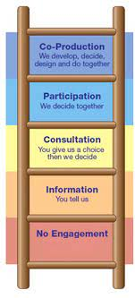
Patient and public involvement (PPI), service user involvement, lay involvement or consumer involvement
Involvement in research = active partnership between members of the public and researchers… members of the public work alongside the research team and are actively involved in contributing to the research process as advisers and possibly
as co-researchers, that is different from co-production
Engagement = information and knowledge about research is provided and disseminated to or by the public.
Participation refers to the process of people taking part in the research study.
These activities are different but are also linked and complement each other.
https://bepartofresearch.nihr.ac.uk
Standards for Public Involvement in Research: https://sites.google.com/nihr.ac.uk/pi-standards/home

Slide 22
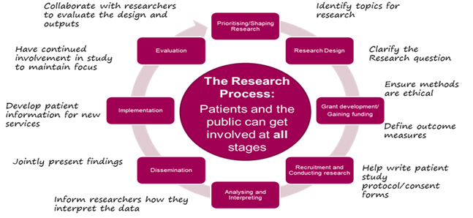
Involving the public in the research cycle
https://oxfordbrc.nihr.ac.uk/ppi/ppi-researcher-guidance/ppi-and-the-research-pathway/

Slide 23
Get involved in research
We want give patients and carers a voice to help shape research projects from the beginning and ensure PSPA research reflects their views
Identify the questions that patient and carers would like answering
Review our research outputs e.g., leaflet and website pages
Be part of our research committee
Be part of the organising committee of the next Research Information Day in Feb2023
Help us review research proposal
This will enable patients to participate in clinical trials and other research studies
Please contact at
research@pspassociation.org.uk

Slide 24
Future events
PSPA Research Information Day ‘’Causes, Cure, and Care’’
Friday 03 February 2023 – 10am to 3.30pm
Registration opens in November 2022
Session One - Observational studies – what are they for and what have we learned?
Session Two – Causes and cures: how technologies can help
Session Three – Clinical Trials update
Session Four – Care: navigating and improving the health and social care system
Session Five – Patients voices using surveys and focus groups
PSPA & CurePSP symposium 2024
For scientific and professional audience

